Slide 1
Modelling lipid phase separation for applications in drug delivery
Ching Ting Roy Ng and Samantha Tran
BIOE 230 Final Project
Department of Bioengineering @ University of California, Merced

Slide 2
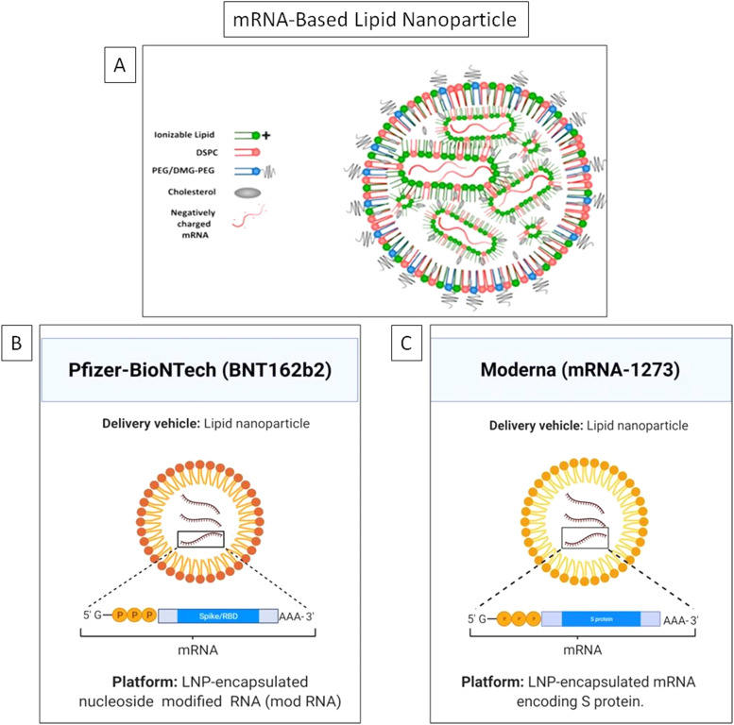
Rationale
Mixed lipid systems can serve as effective carriers for drugs, vaccines, genes, and antimicrobial agents
A deeper understanding of the molecular-level interactions within mixed lipid systems under various physiological conditions is essential for R&D
Modelling mixed lipid systems allows us to gain insights into the basic mechanisms that drive those interactions
i.e. lipid phase separation
From Wang M et al., Langmuir 2018; Karve S et al. Langmuir 2008.
Adapted from Khurana A. et al., Nano Today 2021.
Notes:
The past two decades have seen a surge in the medical use of nanotechnology.
Mixed lipid systems can serve as effective carriers for drugs, vaccines, genes, and antimicrobial agents
For example, most well known now is mRNA lipid nanoparticles like the covid vaccines
However, to fully exploit these technologies, a deeper understanding of the molecular-level interactions within mixed lipid systems under various physiological conditions is essential for R&D
Modelling mixed lipid systems allows us to gain insights into the basic mechanisms that drive those interactions
i.e. lipid phase separation

Slide 3
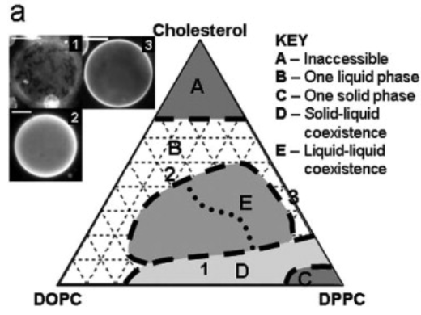
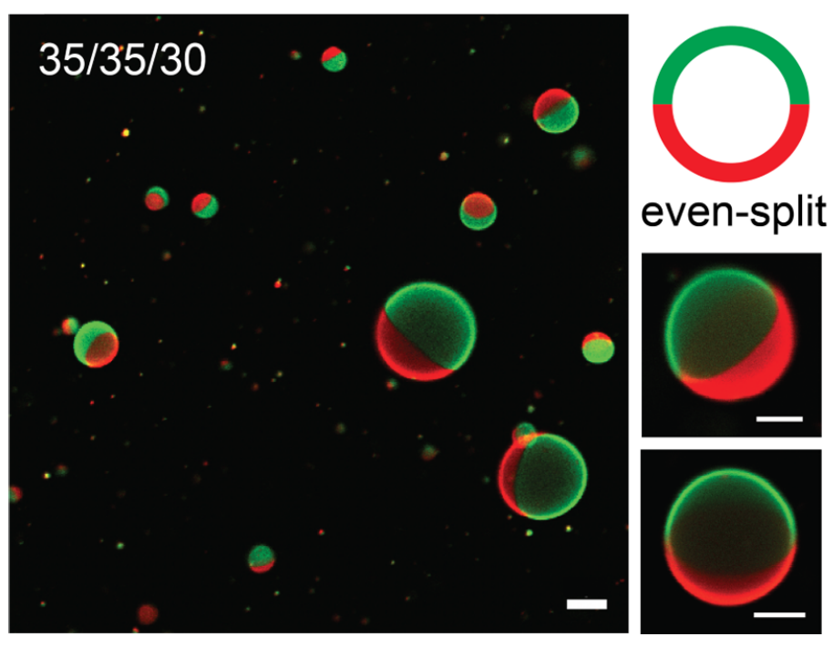

Background
Phase separation occurs when components in a system separate into distinct phases due to differences in their affinities/interactions
Liquid-Liquid Phase Separation (LLPS):
Most studied LLPS lipid system is DOPC:DPPC:Cholesterol.
Temperature-dependent
Experimental observations:
Two coexisting liquid phases observed across a wide range of lipid composition and temperature.
One phase enriched in unsaturated lipid.
Other phase enriched in saturated lipid and cholesterol.
Adapted from Poruthoor AJ et al., Biophysical Journal 2023; Veach SL, Keller SL, Biophysical Journal 2003; Wang M et al., Langmuir 2018
Notes:
Broadly, phase separation occurs when lipid systems separate into distinct liquid phases due to differences in their affinities and interactions
Liquid-liquid phase separation (LLPS) is a phenomenon where certain components within the lipid system separate into distinct liquid phases
This phase separation occurs in multiple parts of cells, including the cell membrane, where the “lipid raft” hypothesis posits the formation of ordered domains floating in a “sea” of disordered lipids.
DOPC:DPPC:Chol
Ternary mixture of high melting temperature (saturated) lipids, low melting temperature (usually unsaturated) lipids, and cholesterol.

Slide 4
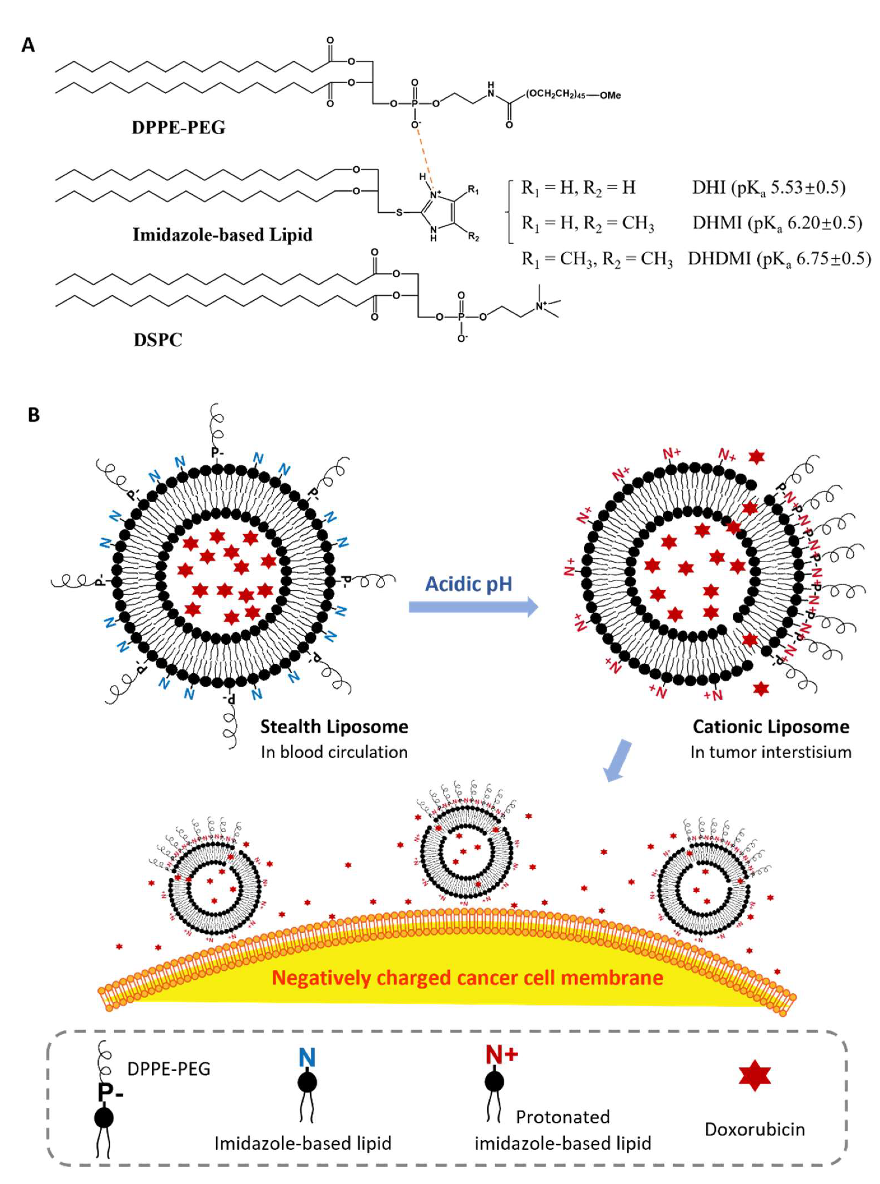
Background
Imidazole-based pH-sensitive convertible liposome (ICL) compositions, inspired by experimental work on doxorubicin (DOX) delivery for cancer treatment
Some mixed lipid liposomes show pH-dependent permeability, enabling controlled drug release in response to stimuli like pH changes
The acidic microenvironment can significantly impact lipid behavior and phase separation dynamics within liposomes → affect drug delivery
Due to the acidic tumor interstitium investigating pH-sensitive liposome composition becomes crucial
From Karve S et al., Langmuir 2008.
Adapted from Huang R et al., Pharmaceuticals 2022.
Notes:
- Liposomes with mixed lipid membranes show pH-dependent permeability, enabling controlled drug release in response to stimuli like pH changes2.
The acidic microenvironment in cancer can significantly impact lipid behavior and phase separation dynamics within liposomes, particularly affecting or in the case of ICL functionalized to carry out drug delivery.
- Due to the acidic tumor interstitium resulting from metabolic processes4, investigating pH-sensitive liposome composition becomes crucial.
Our simulation can provide valuable insights method into the dynamics of these systems, including the LLPS phenomenon, paving the way for the design and optimization of pH-sensitive liposomal delivery carriers with precise control over drug release mechanisms.

Slide 5
Research Question
How can we use computer simulations to predict the phase separation behavior of mixed lipid systems?
By investigating the dynamics of these systems, including the LLPS and ICL compositions, simulations can provide insights into the design and optimization of drug delivery carriers for better control over drug release mechanisms
This research can advance our understanding of lipid membrane behavior and contribute to the development of nano-drug delivery systems targeting cancer and other diseases

Slide 6
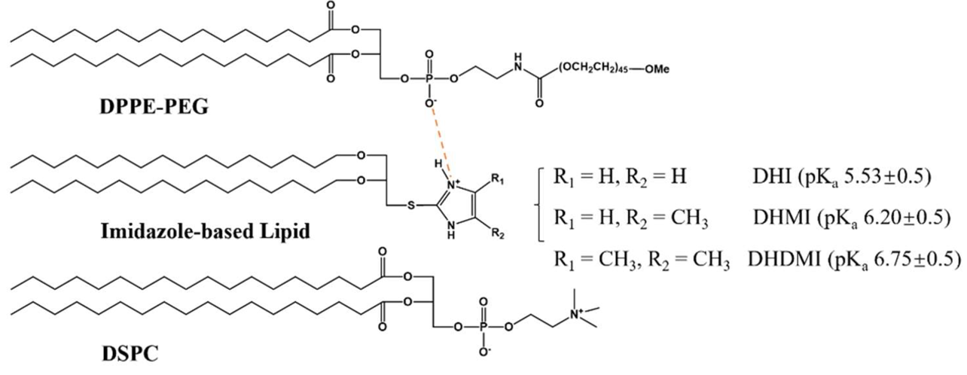

Objectives & Approach
Model DOPC:DPPC:Cholesterol system as a preliminary
Full atom representation and Martini coarse grained model
Model ICL system
Modify lipids and force fields
Extract quantitative index to measure phase separation
From Veach SL, Keller SL, Biophysical Journal 2003; Adapted from Huang R et al., Pharmaceuticals 2022.

Slide 7


Methods
Generate bilayer membrane model with CHARMM-GUI
Set up simulation and modify MD file
Perform equilibration
Anneal temperature from 316 K (above melting temperature) to 293 K (room temperature over 1 ns for production run
From CHARM-GUI and GROMACS website.

Slide 8
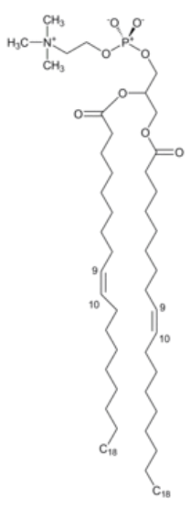
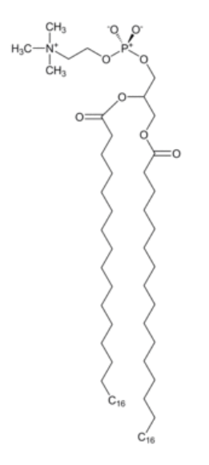
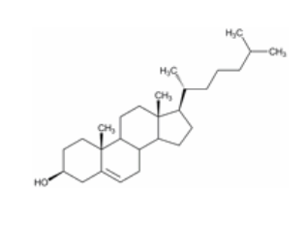
DOPC DPPC Cholesterol
From CHARMM-GUI website.
Notes:
Ternary mixture of high melting temperature (saturated) lipids, low melting temperature (usually unsaturated) lipids, and cholesterol.

Slide 9

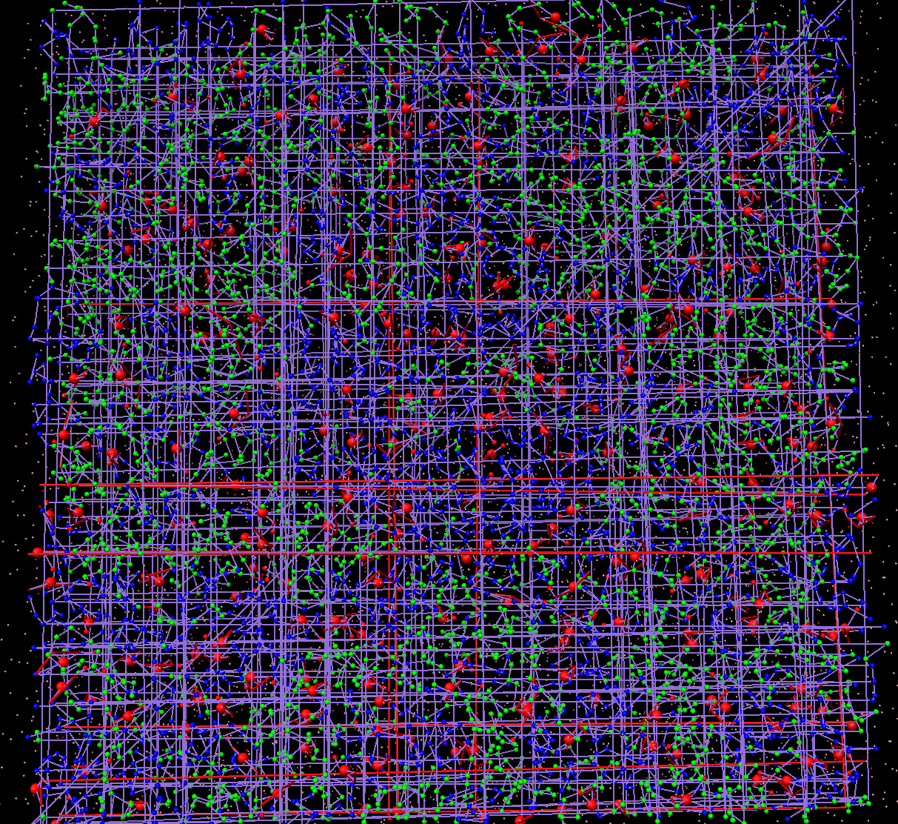
Results
Before equilibration After equilibration
Notes:
equilibration

Slide 10
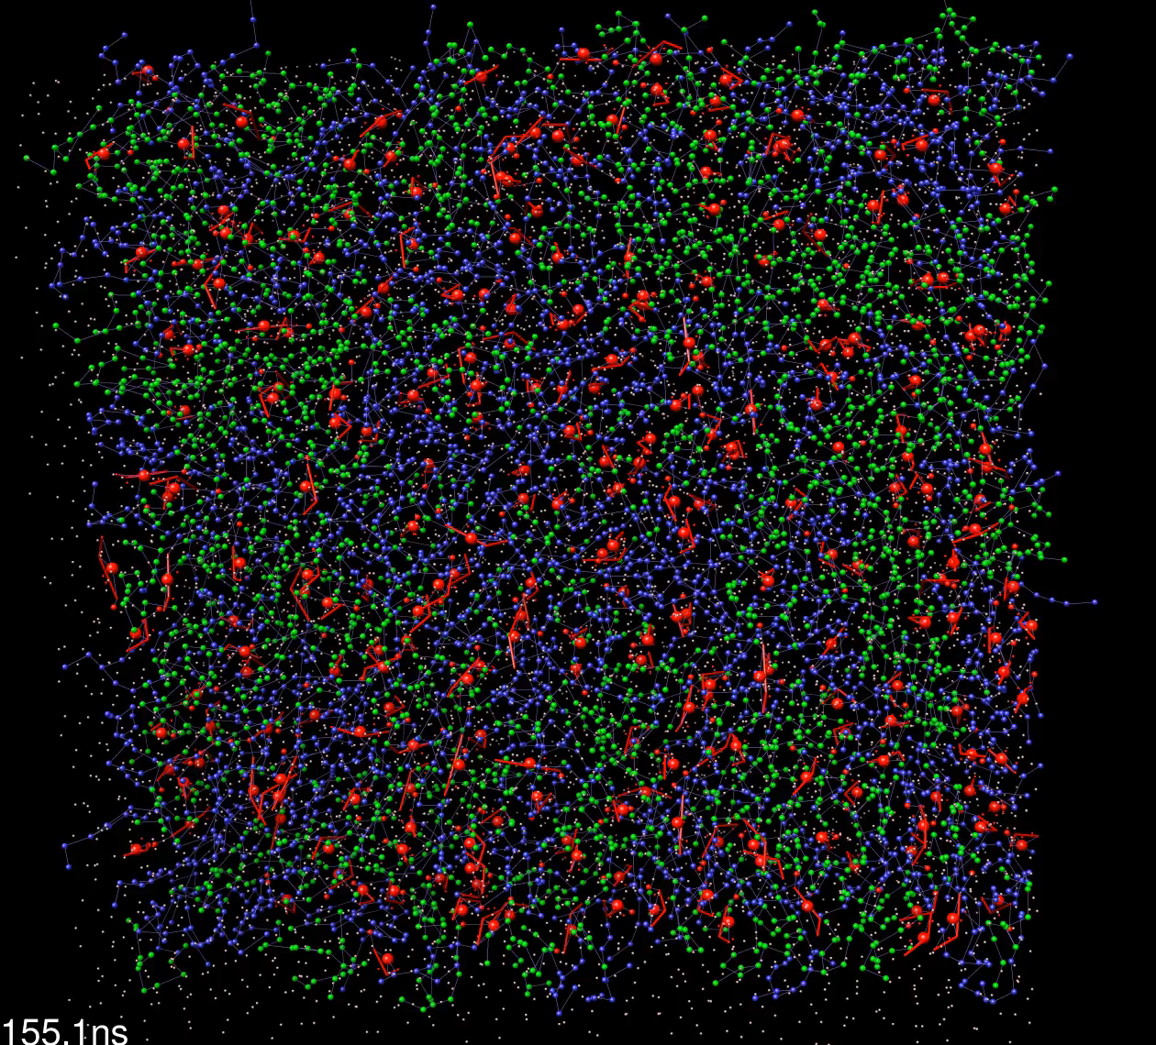
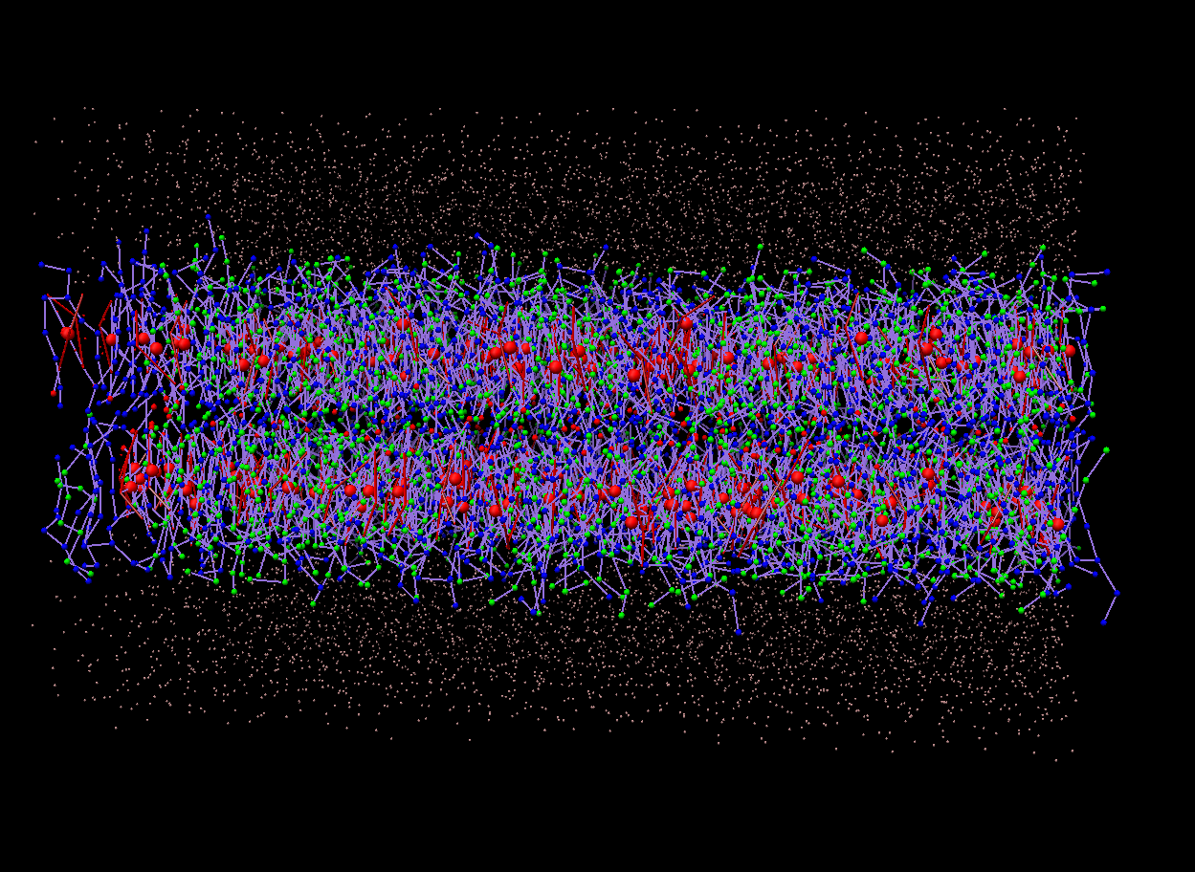
Results
DPPC
DOPC
Cholesterol
Notes:
Initial T: 316 K
After 1 ns, 293 K (room temp)
Solvent – water
Need to modify force fields

Slide 11
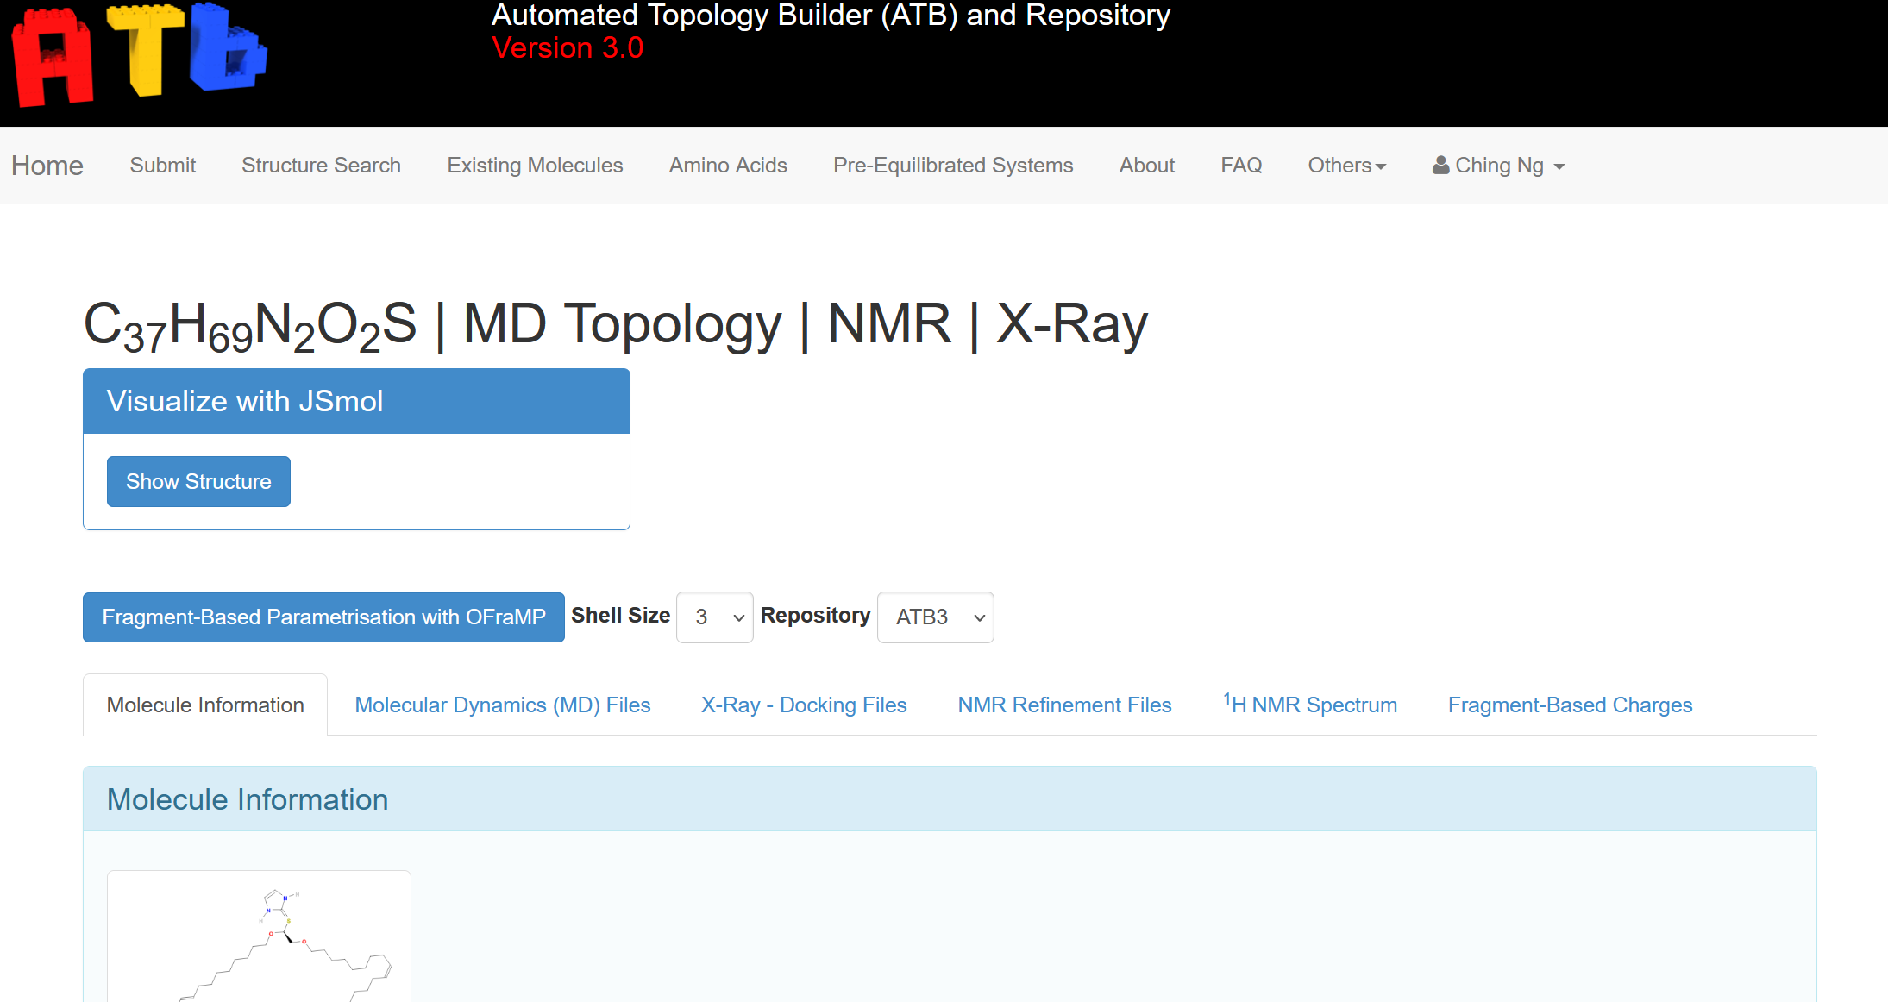
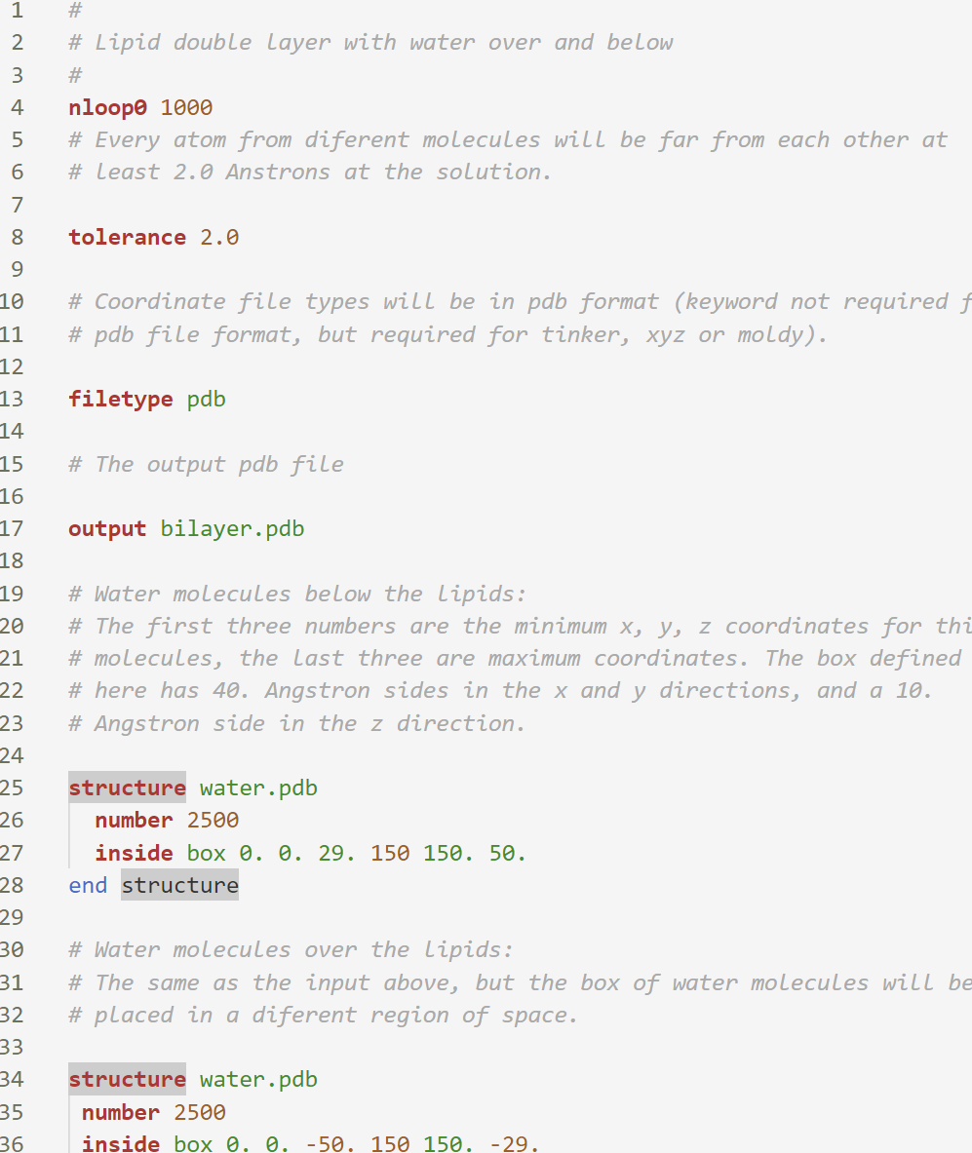
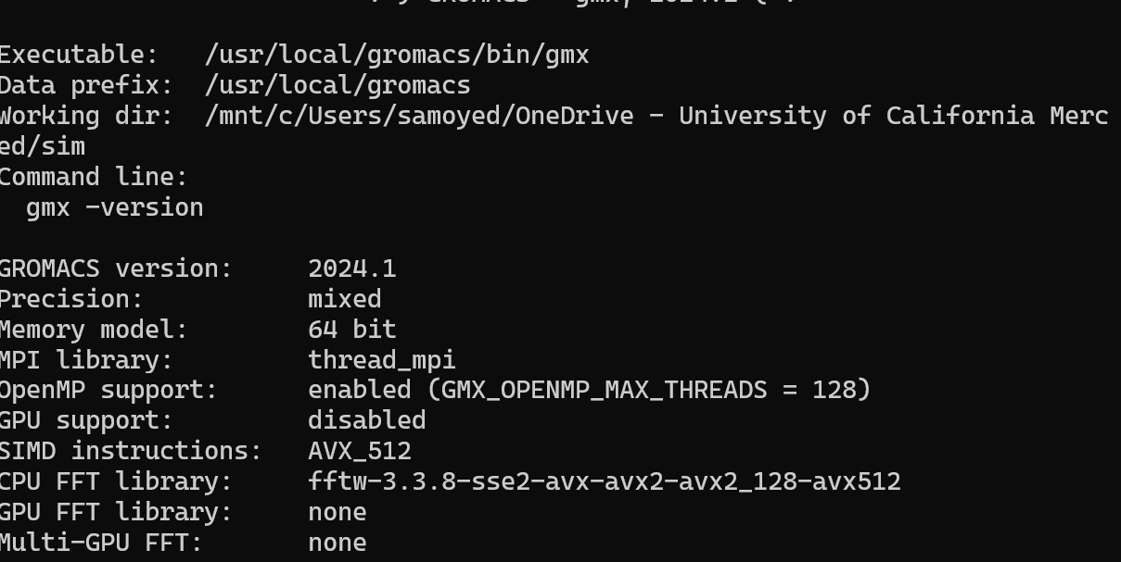
Future Directions
To model more complex phase-separated lipid systems like ICL:
Generate force field parameters with ATB
Assemble membrane with PACKMOL
Run simulation on GROMACS
Notes:
ATB : Automated Topology Builder development of molecular force fields for Molecular Dynamics or Monte Carlo simulations of biomolecular systemsallows us to select our molecules of choice with the associated force field parameters (charge, mass of atoms, bond angles, etc.)
PACKMOL creates an initial point for molecular dynamics simulations by packing molecules in defined regions of space. The packing guarantees that short range repulsive interactions do not disrupt the simulations

Slide 12
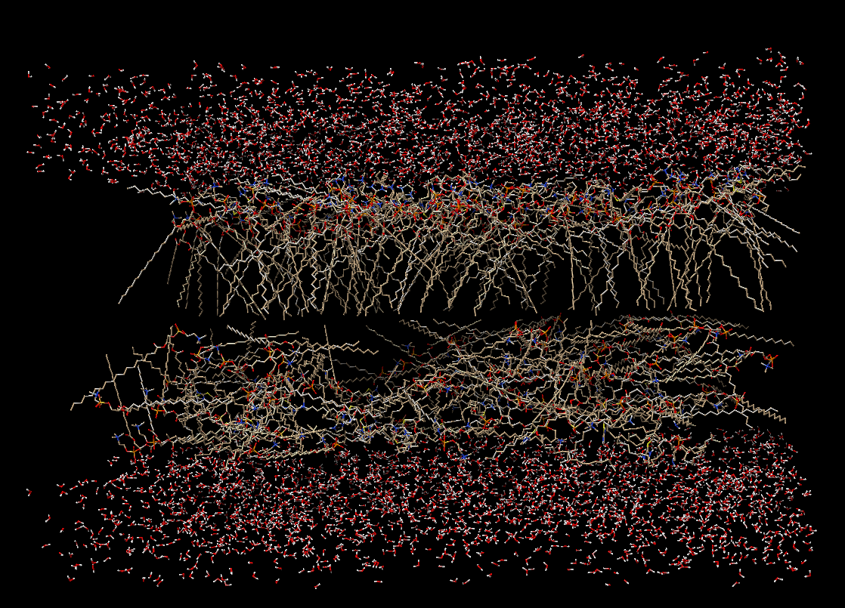
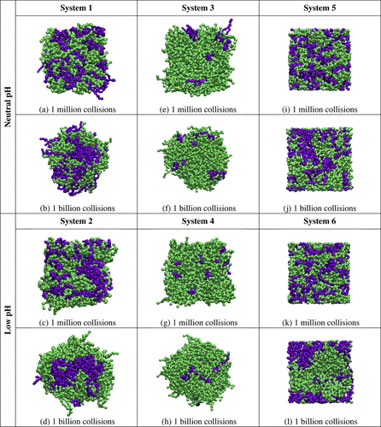
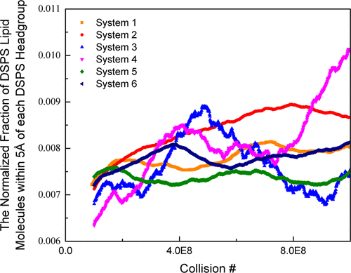
Future Directions
PACKMOL configuration of ICL lipid bilayer
Model more complex phase-separated lipid systems like ICL
Extract quantitative data to measure phase separation
i.e. phase separation index
1
3
2
4
Adapted from Curtis EM et al., Langmuir 2015.
Notes:
In Curtis et al extract and normalize time-averaged percentage of lipid molecules within a 5 Å radius of like-headgroup (coarse-grained site 1 on each PEG lipid molecule). The higher the fraction, the greater the phase separation of the bilayer.
Figure captio: plot shows that the number of DSPS lipids with a DSPS nearest neighbor is higher for Systems 2 and 4 than it is for Systems 1 and 3. This indicates that Systems 2 and 4 separate to a greater extent by 1 billion collisions than do Systems 1 and 3.

Slide 13
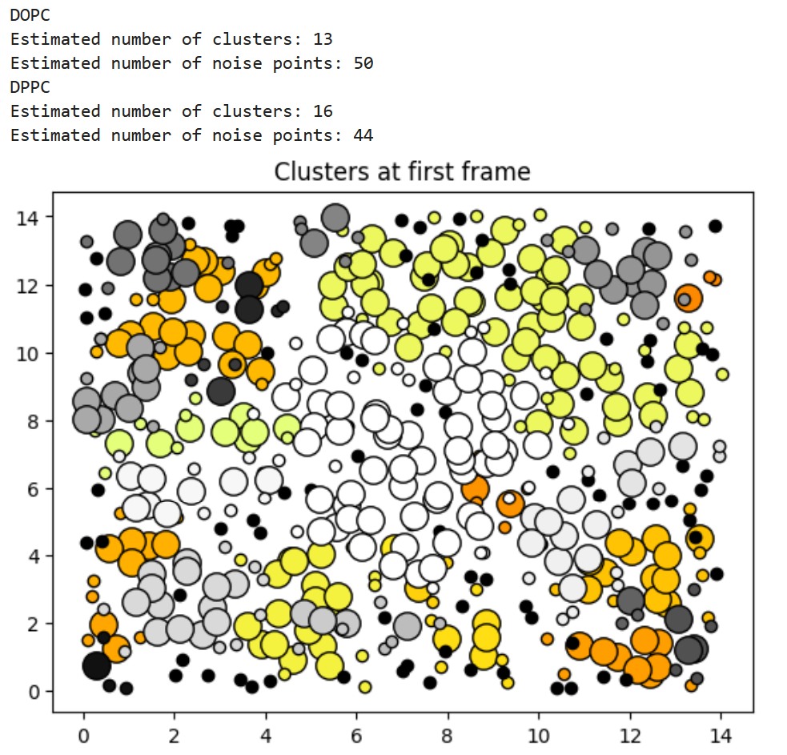
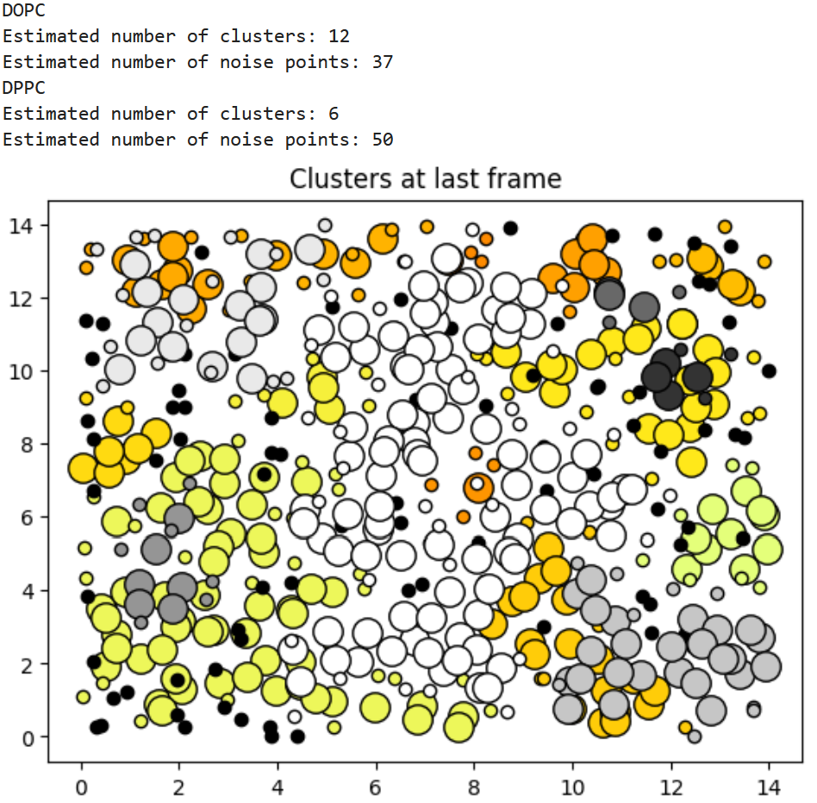
Evaluating extent of phase separation (clustering) using DBSCAN
eps = 1: defines the neighborhood around a data point i.e. if the distance between two points is lower or equal to ‘eps’ then they are considered neighbors.
min_samples = 5: minimum number of neighbors (data points) within eps radius
DBSCAN or density-Based Spatial Clustering of Applications with Noise: Unlike traditional clustering algorithms, DBSCAN doesn't require the number of clusters to be specified beforehand. Instead, it groups together points that are closely packed together while marking points that are in low-density regions as outliers.
Notes:
DBSCAN stands for Density-Based Spatial Clustering of Applications with Noise.
clustering algorithm
Unlike traditional clustering algorithms, DBSCAN doesn't require the number of clusters to be specified beforehand. Instead, it groups together points that are closely packed together while marking points that are in low-density regions as outliers.
eps=1, min_samples=5

